Slide 1
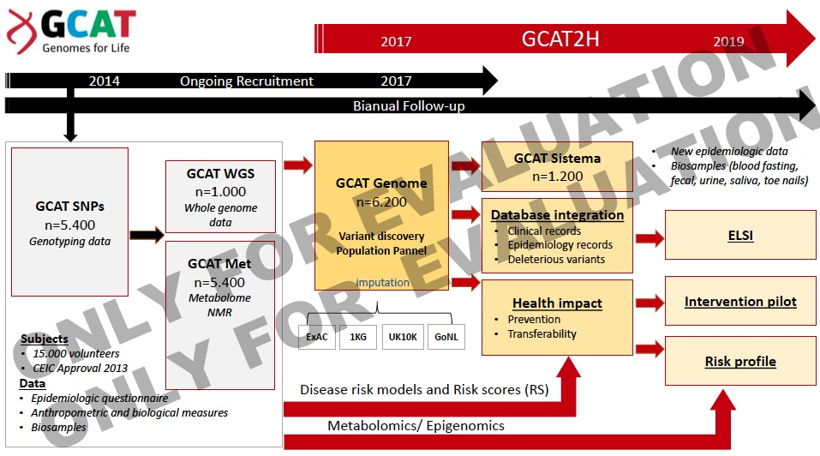

Slide 2
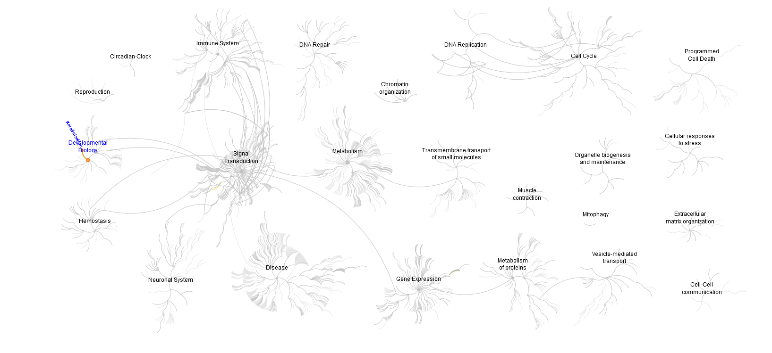
http://www.reactome.org/PathwayBrowser

Slide 3
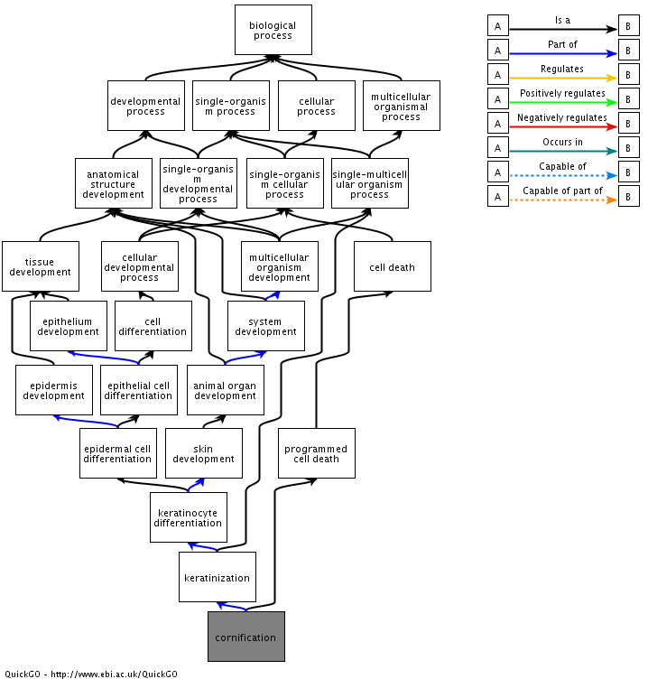
cornification
Ontology Biological Process
Definition A type of programmed cell death that occurs in the epidermis, morphologically and biochemically distinct from apoptosis. It leads to the formation of corneocytes, i.e. dead keratinocytes containing an amalgam of specific proteins (e.g., keratin, loricrin, SPR and involucrin) and lipids (e.g., fatty acids and ceramides), which are necessary for the function of the cornified skin layer (mechanical resistance, elasticity, water repellence and structural stability).
http://www.ebi.ac.uk/QuickGO/GTerm?id=GO:0070268#info=1&term=ancchart

Slide 4
